Slide 1

B.Tech Project Presentation
High-Temperature X-Ray Diffraction (XRD) of Additively Manufactured 316L Steel.
Presented By : Jaya Vardhan
Supervised By : Dr. Eswara Prasad Korimilli
PhD Advisor : Sourav Kumar

Slide 2
Overview
Literature Survey
Features of 316L Steel
Additive Manufacturing
Directed Energy Deposition
Thermogravimetric analysis (TGA)
X-Ray Diffraction (XRD)
Diffraction and Bragg’s Law
Introduction to XRD
Results and Analysis
Further Plan

Slide 3

316L Steel
Type 316L stainless steel is a molybdenum bearing austenitic. It is more resistant to general corrosion and pitting than conventional nickel chromium stainless steels such as 302-304.
L-grades have 0.03% carbon maximum. L-grades are resistant to sensitization in short-term exposures or heat treatments. L-grade often have slightly lower strength than standard stainless steels.
Composition of 316L Steel:
https://www.azom.com/article.aspx?ArticleID=2382
https://www.lenntech.com/stainless-steel-316l.htm
Notes:
Low Carbon – High Temperature Applications and Weldability.
C – Increases hardness and strength of Pure Iron.
Ni - Austenitic Stabilizer. (Non-magnetic).
Cr – Corrosion Resistance.
Mo – High temperature Strength, Resist Hydrogen embrittlement (Traps Hydrogen atoms and prevents their diffusivity).
Mn – Improves hot working properties, helps in removing impurities in steel production.
Si – Acts as deoxidiser in steel production
S and P – Improves machinability when added in small amounts. (Detrimental effects on corrosion resistance and weldability)
N – Pitting corrosion resistance.
Sensitization – Material becomes susceptible to intergranular corrosion due to the formation of chromium carbides.

Slide 4

316L Steel
Characteristics:
High Creep Resistance
Excellent Formability
Corrosion Resistance
High Temperature Tensile strength
Applications:
Chemical and Pharmaceutical Industry
Petroleum Refining Equipment
Heat Exchanger Tubes
Evaporators
Marine Applications
Automotive and Aerospace
316L in a Chemical Processing Plant
https://www.lenntech.com/stainless-steel-316l.htm

Slide 5
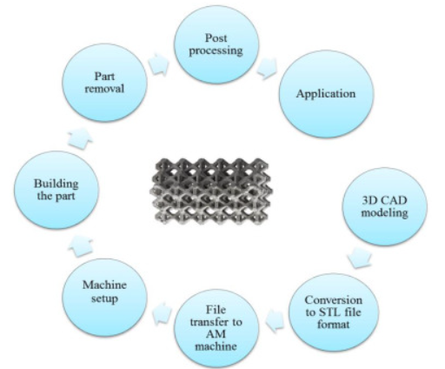
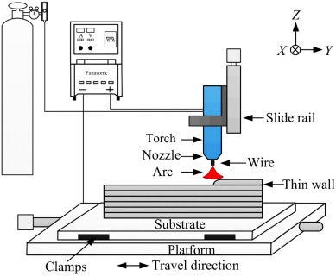
Additive Manufacturing
Additive manufacturing (AM), also known as 3D printing, is a process used to fabricate a physical object from a three-dimensional (3D) digital model, typically by laying down and bonding many successive thin layers of materials.
8 Steps of any Additive Manufacturing Process
Additive Manufacturing Schematic
https://doi.org/10.1016/j.matdes.2021.109654

Slide 6

Additive Manufacturing
Types of Additive Manufacturing Processes:
https://manufacturing.report/articles/which-additive-manufacturing-process-is-right-for-you

Slide 7
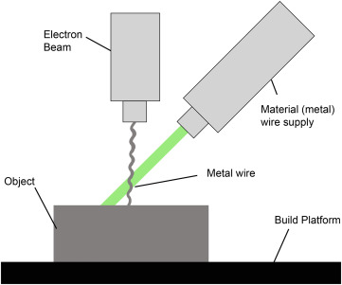
Directed Energy Deposition
Directed Energy Deposition (DED) is an Additive Manufacturing (AM) process that is highly adapted for the deposition of high-performance materials such as stainless steels, tool steels, alloy steels, shape memory alloys (SMAs), ceramics, composites, etc.
DED uses a high energy density heat source (laser, electron beam, or plasma/electric arc) that is focused on the substrate, forming a small melt pool and simultaneously melting the feedstock material delivered into the melt pool in the form of either powder or wire.
As the heating source moves forward, the deposited metal solidifies on the substrate, forming a metal track.
The metal tracks overlap each other based on the pre-defined hatch spacing (i.e., the distance between successive metal tracks).
https://doi.org/10.1016/j.mattod.2021.03.020

Slide 8
Directed Energy Deposition
After completing a layer, the deposition head and the feedstock delivery system move upward by a small distance (slice thickness) to deposit the next layer
Thus, deposition of all layers produces a 3D component, similar to the computer aided design (CAD) model.
ASTM 3413 lists the following advantages of the DED process:
A broad range of feedstock materials.
Often better static and dynamic mechanical properties in the as-deposited condition than in PBF-deposited parts.
High deposition rates.
Manufacturing of larger parts is possible compared to PBF.
https://doi.org/10.1016/j.mattod.2021.03.020

Slide 9
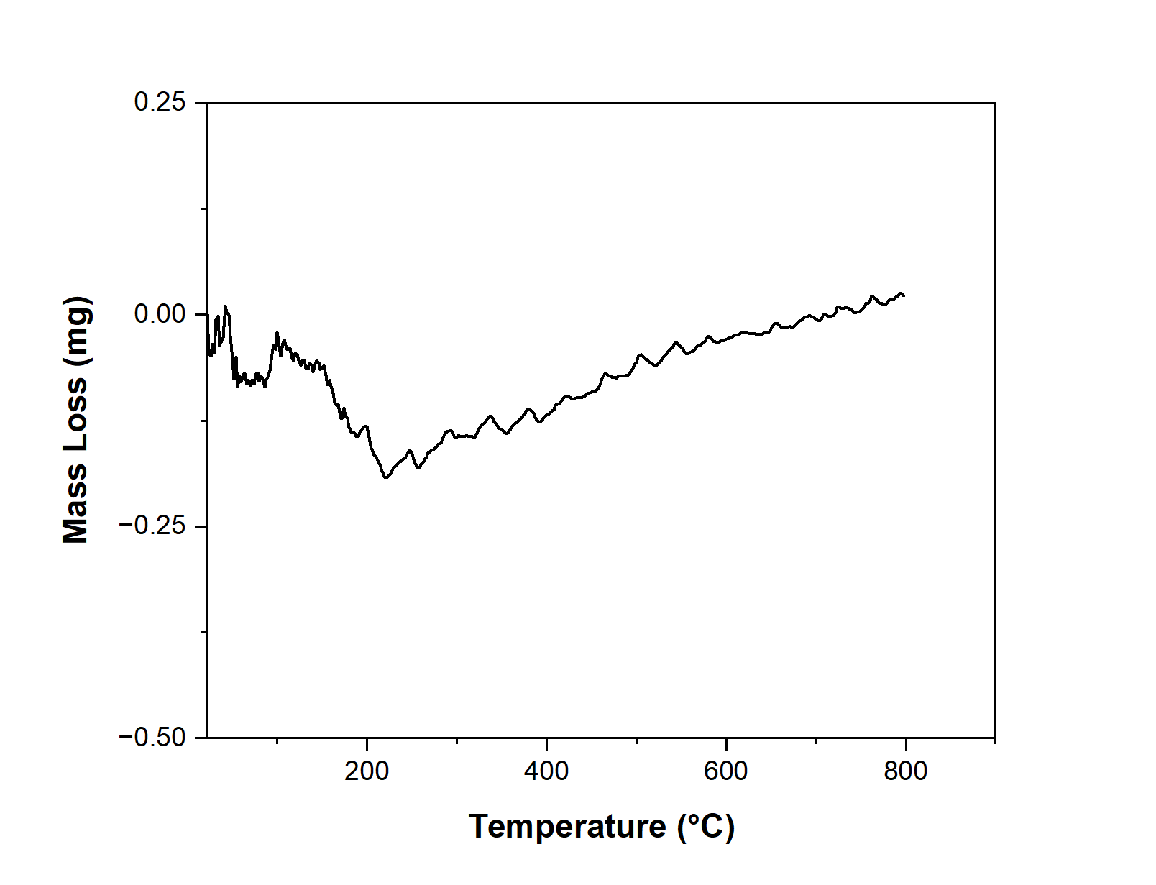
TGA
Thermogravimetric Analysis (TGA) is a technique in which the mass of a substance is monitored as a function of temperature and time as the sample specimen is subjected to a controlled temperature program in a controlled atmosphere.
TGA is done prior to XRD to check for mass loss and melting of the sample.
The descending TGA thermal curve indicates a weight loss occurred.
Initial dip in the graph is due to the removal of porosity.
Conclusion: No mass loss occurred. Sample is ready for high temperature XRD
TGA of DED 316L
Notes:
This indicates that our sample is ready for high temperature XRD.

Slide 10
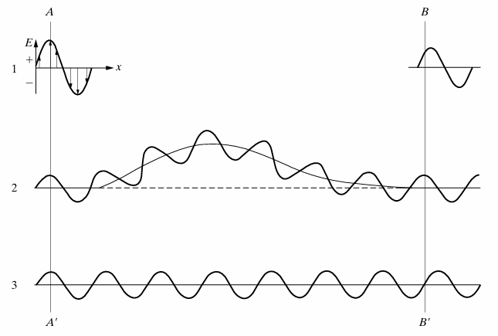
Introduction to Diffraction
Diffraction is a scattering phenomenon which occurs whenever wave motion encounters a set of regularly spaced scattering objects, given that the wavelength of the wave motion is of the same order of magnitude as the repeat distance between the scattering centers.
Diffraction is due essentially to the existence of certain phase relations between two or more waves.
The greater the path difference, the greater the phase difference.
Differences in the path length of various rays arise naturally when considering how a crystal diffracts X-rays.
Effect of path difference on relative phase.
B.D. Cullity, S.R. Stock, Elements of X-Ray Diffraction, Pearson Education Limited

Slide 11
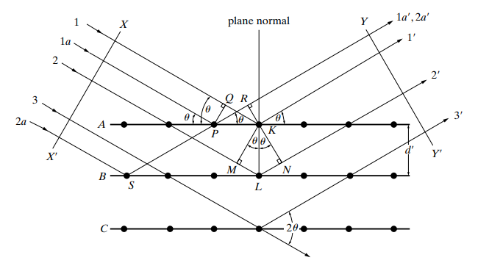


Bragg’s Law
Atoms scatter incident x-rays in all directions. In some of these directions the scattered beams will be completely in phase and so reinforce each other to form diffracted beams.
Path Difference between${ 1}^{′}$and$1a^{′}:$
$$QK −PQ=PKCosθ −PKCosθ=0$$
This implies that ${ 1}^{′}$and$1a^{′}$are in same phase.
Diffraction of x-rays by a crystal.
B.D. Cullity, S.R. Stock, Elements of X-Ray Diffraction, Pearson Education Limited

Slide 12
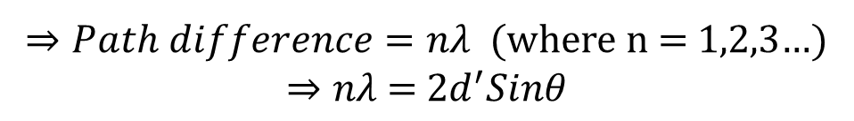

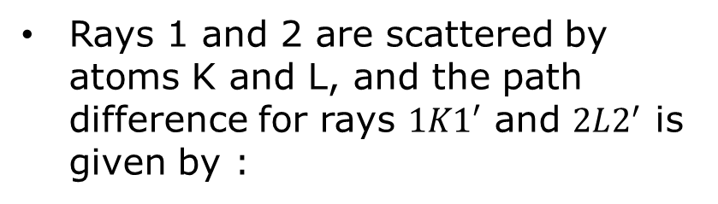
Bragg’s Law
Rays 1 and 2 are scattered by atoms K and L, and the path difference for rays $1K1′$ and $2L2^{′}$ is given by :
$$ML+LN=d^{′}Sinθ+d^{′}Sinθ$$
Constructive Interference:
Constructive interference occurs when the path difference between the two waves is an integer multiple of the wavelength (𝜆).
Diffraction of x-rays by a crystal.
$⇒Path difference=n\text{λ}$ (where n = 1,2,3…)
$$⇒n\text{λ}\text{ = 2}d^{′}Sinθ$$
B.D. Cullity, S.R. Stock, Elements of X-Ray Diffraction, Pearson Education Limited
Notes:
Phase difference = (2pi/wavelength)*path difference

Slide 13
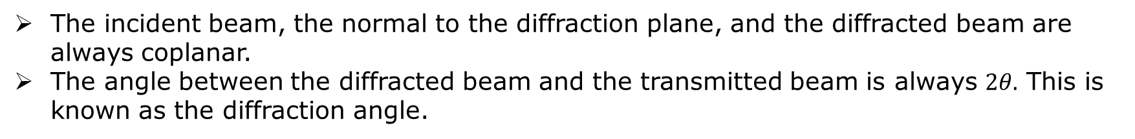
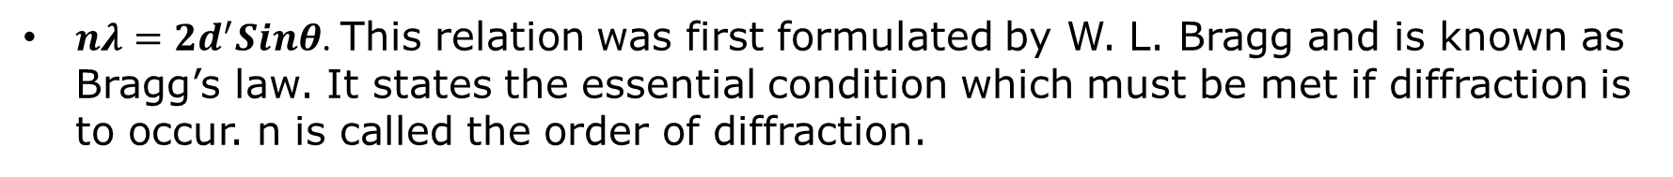
Bragg’s Law
$nλ=2d^{′}Sinθ$. This relation was first formulated by W. L. Bragg and is known as Bragg’s law. It states the essential condition which must be met if diffraction is to occur. n is called the order of diffraction.
It is the constructive interference of scattering from the atoms which produces diffracted intensity.
Two geometrical facts are worth mentioning :
The incident beam, the normal to the diffraction plane, and the diffracted beam are always coplanar.
The angle between the diffracted beam and the transmitted beam is always $2θ.$ This is known as the diffraction angle.
The condition for diffraction at any observant angle $2θ$ is :
$\frac{nλ}{2d′}=Sinθ≤1 ⇒ nλ≤2d$’ (where n = 1,2,3…)
B.D. Cullity, S.R. Stock, Elements of X-Ray Diffraction, Pearson Education Limited

Slide 14
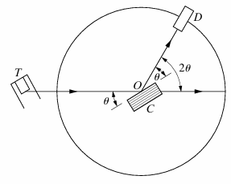
XRD
XRD is a high-precision non-destructive technique that provides important information about the structural characteristics of the materials by enabling chemical composition identification.
Every crystalline substance gives a pattern; the same substance always gives the same pattern; and in a mixture of substances, each produces its pattern independently of the others – Hull (1919).
Working Principle of XRD:
X-rays from the tube T are incident on a crystal C which may be set at any desired angle to the incident beam by rotation about an axis through O. D is a detector which measures the intensity of the diffracted x-rays.
B.D. Cullity, S.R. Stock, Elements of X-Ray Diffraction, Pearson Education Limited
Schematic of XRD
DOI: 10.1002/cjce.23747
Notes:
Why angle with plane is considered and not angle with normal?

Slide 15
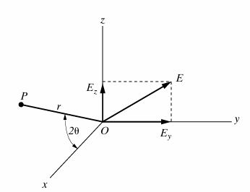
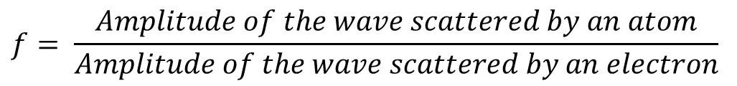
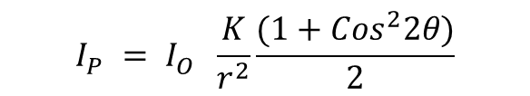
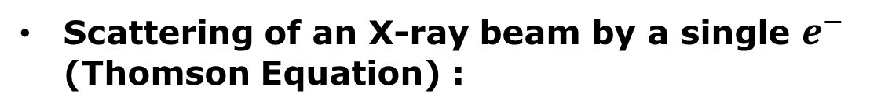
XRD
Scattering of an X-ray beam by a single $e^{−}$ (Thomson Equation) :
$$I_{P}^{}= I_{O}^{} \frac{K}{r^{2}}\frac{(1+{Cos}^{2}2θ)}{2}$$
Scattering by an Atom: When an x-ray beam encounters an atom, each electron in it scatters part of the radiation coherently in accordance with the Thomson equation.
Coherent scattering of x-rays by a single electron.
$$f= \frac{Amplitude of the wave scattered by an atom}{Amplitude of the wave scattered by an electron}$$
$"f "$ is known as “the atomic scattering factor”. It is used to describe the efficiency of scattering of a given atom in a given direction.
B.D. Cullity, S.R. Stock, Elements of X-Ray Diffraction, Pearson Education Limited

Slide 16

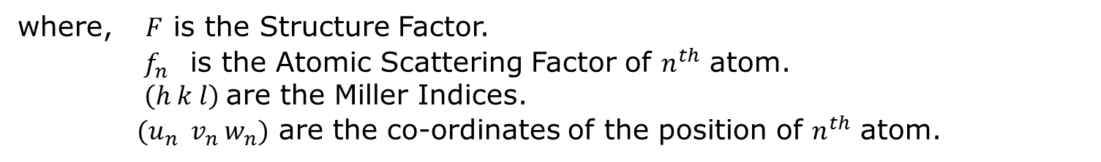

XRD
Structure Factor: The resultant wave scattered by all the atoms of the unit cell.
$$F_{hkl}^{}= Σ f_{n} . e^{2πi(hu_{n}^{}+kv_{n}+lw_{n})}$$
where, $F$ is the Structure Factor.
$f_{n}^{}$ is the Atomic Scattering Factor of $n^{th}$ atom.
$\left(h k l\right)$are the Miller Indices.
${ (u}_{n}^{}{ v}_{n} w_{n})$ are the co-ordinates of the position of $n^{th}$ atom.
$$|F|= \frac{Amplitude of the wave scattered by all the atoms of a unit cell}{Amplitude of the wave scattered by one electron }$$
The intensity of the beam diffracted by all atoms of the unit cell in a direction predicted by Bragg’s law is proportional to ${\left|F\right|}^{2}.$
$$I ∝{\left|F\right|}^{2}$$
B.D. Cullity, S.R. Stock, Elements of X-Ray Diffraction, Pearson Education Limited

Slide 17
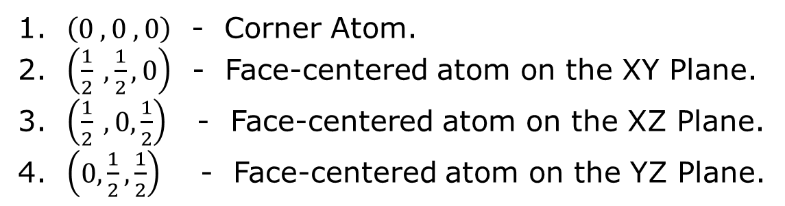
XRD
Structure Factor for FCC Unit cell: The FCC unit cell contains 4 atoms. These 4 atoms are positioned at the following fractional coordinates within the unit cell -
$\left(0 , 0 , 0\right)$ - Corner Atom.
$\left(\frac{1}{2} , \frac{1}{2}, 0\right)$ - Face-centered atom on the XY Plane.
$\left(\frac{1}{2} ,0,\frac{1}{2}\right)$ - Face-centered atom on the XZ Plane.
$\left(0,\frac{1}{2},\frac{1}{2}\right)$ - Face-centered atom on the YZ Plane.
$${(F}_{hkl}^{})_{FCC}^{} =f (e^{2πi(h\left(0\right) + k\left(0\right) + l\left(0\right))}+e^{2πi(h\left(\frac{1}{2}\right) + k\left(\frac{1}{2}\right) + l\left(0\right))} +e^{2πi(h\left(\frac{1}{2}\right) + k\left(0\right) + l\left(\frac{1}{2}\right)) }+e^{2πi(h\left(0\right) + k\left(\frac{1}{2}\right) + l\left(\frac{1}{2}\right))} )$$
$${(F}_{hkl}^{})_{FCC}^{} =f (1 +e^{πi(h + k)} +e^{πi(h + l) }+e^{πi(k + l)} )$$
${(F}_{hkl}^{})_{FCC}^{}=4f$ (for unmixed indices) ${(F}_{hkl}^{})_{FCC}^{}=0$(for mixed indices)
Thus, reflections may occur for such planes as (111),(200),and (220) etc
B.D. Cullity, S.R. Stock, Elements of X-Ray Diffraction, Pearson Education Limited

Slide 18


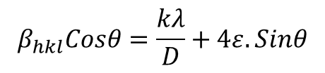
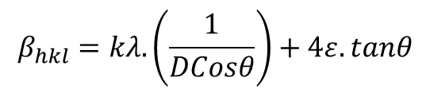
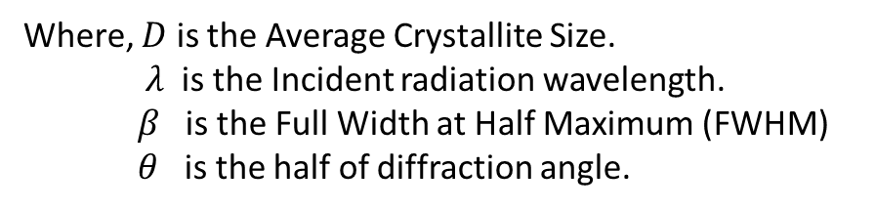

XRD
Scherrer Equation: $D=0.9 λ (\frac{1}{β Cosθ})$
Where, $D$ is the Average Crystallite Size.
$λ$ is the Incident radiation wavelength.
$β$ is the Full Width at Half Maximum (FWHM)
$θ$ is the half of diffraction angle.
Williamson – Hall Analysis: Physical line broadening of X-ray diffraction peak occurs due to the size and micro-strain of the crystal and the total broadening can be written as
$$β_{total}= β_{size}+ β_{strain} …(1)$$
Where $β_{strain}=4ε.tanθ$
($ε$ is micro-strain)
From Scherrer Equation; $β_{size}=kλ.(\frac{1}{DCosθ})$
Substituting these values in $(1)$ gives,
$$β_{hkl}=kλ.\left(\frac{1}{DCosθ}\right)+4ε.tanθ$$
$$β_{hkl}Cosθ=\frac{kλ}{D}+4ε.Sinθ$$
https://doi.org/10.1016/j.matchemphys.2019.122021

Slide 19
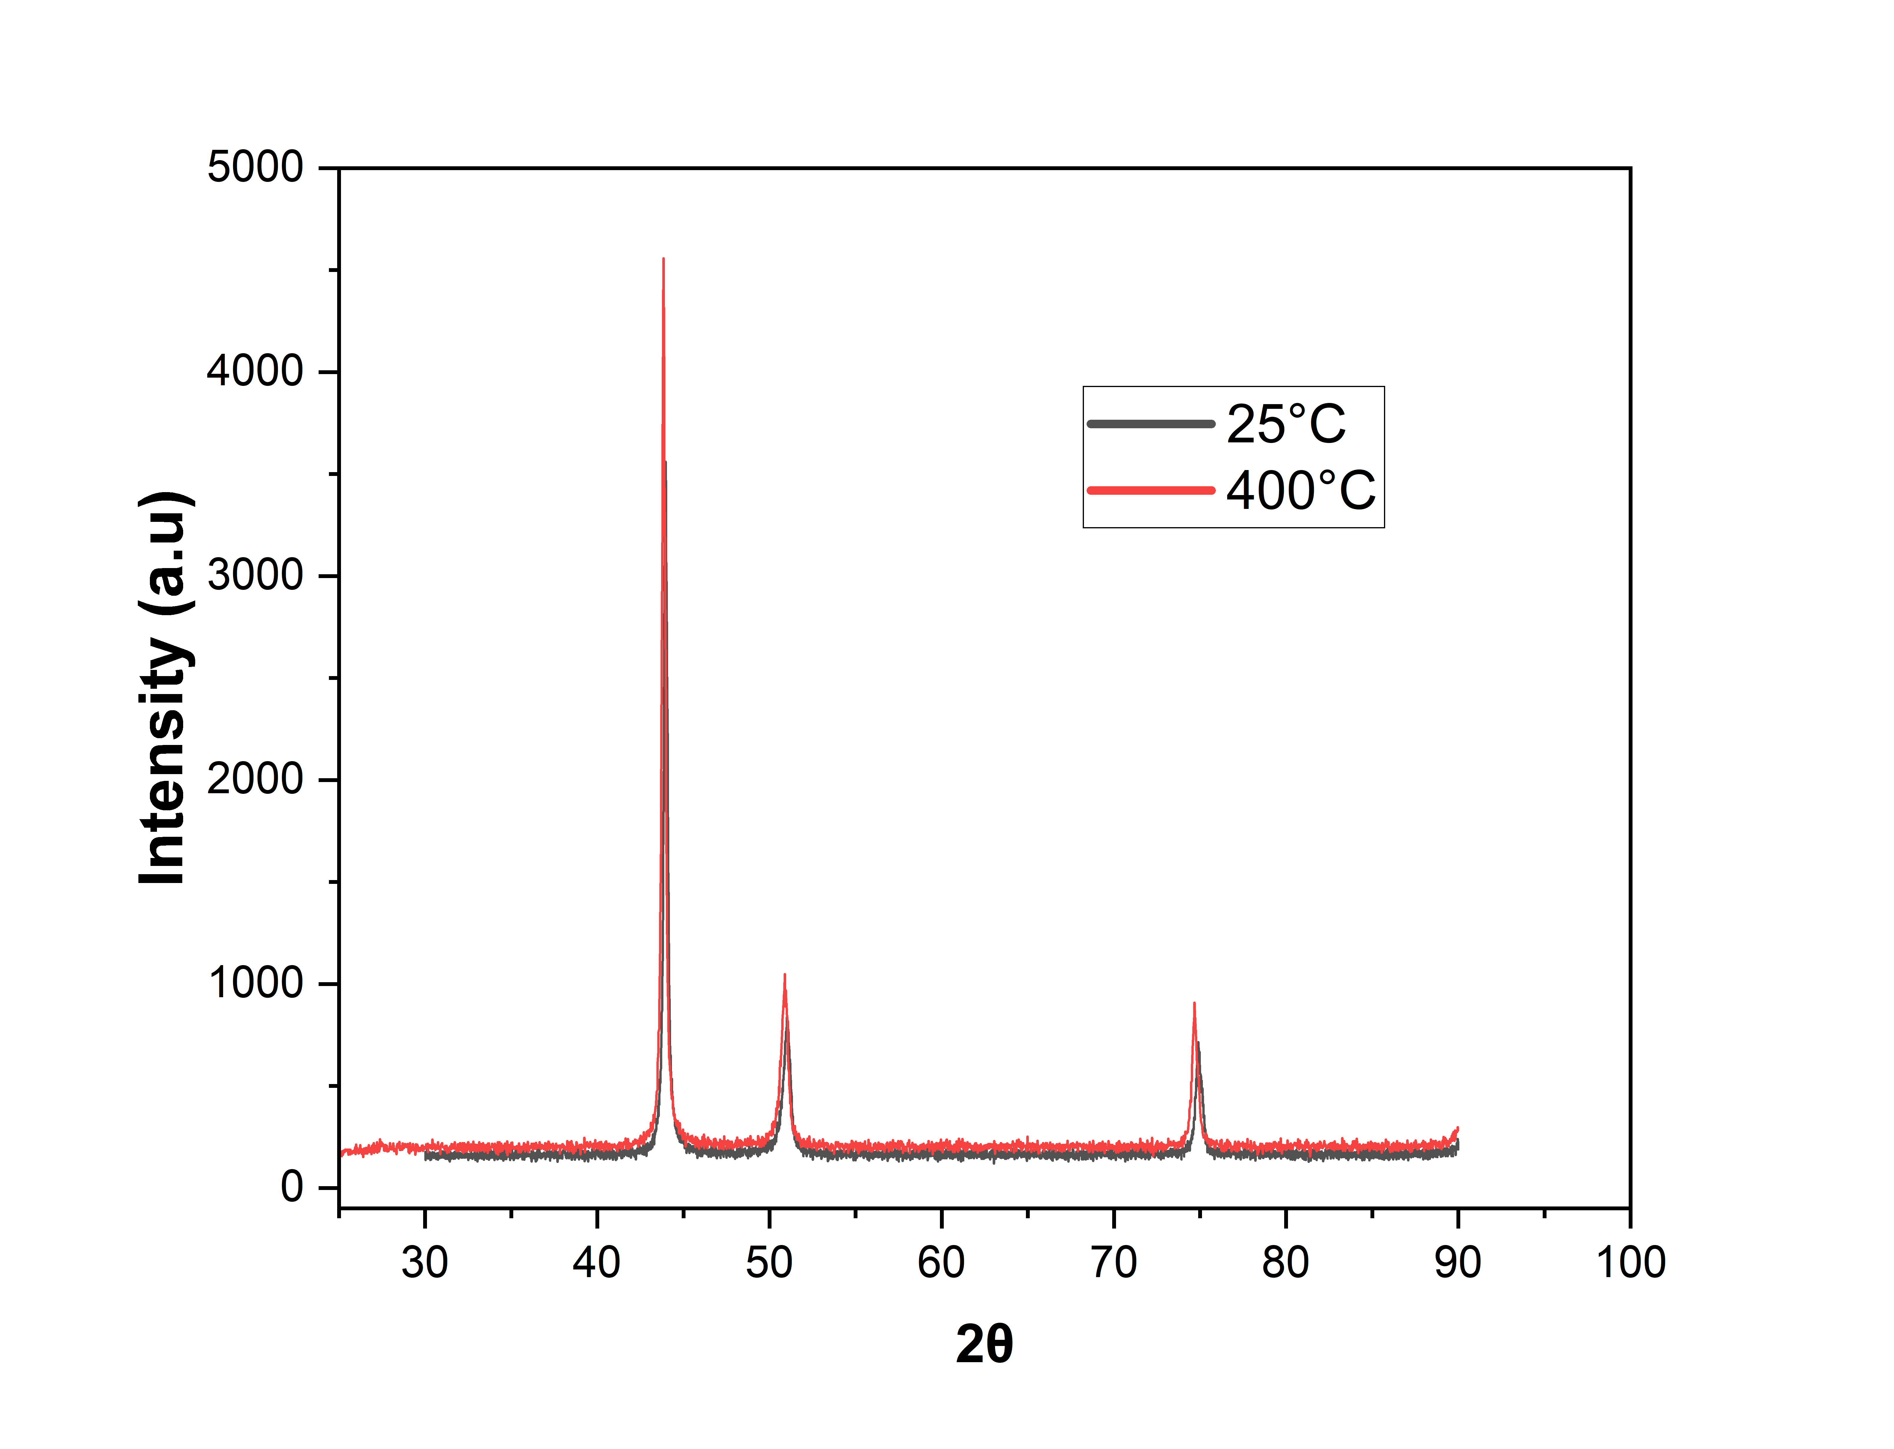
XRD
XRD at 400°C
At 25°C
Peak Position (2θ) | FWHM (β) | D(nm)
43.97279 | 0.29859 | 28.69275602
51.00273 | 0.56361 | 15.61683536
74.93475 | 0.47655 | 21.00343195
At 400°C
Peak Position (2θ) | FWHM (β) | D(nm)
43.85019 | 0.295 | 29.02940915
50.86731 | 0.54255 | 16.21390081
74.69829 | 0.45293 | 22.06389964

Slide 20
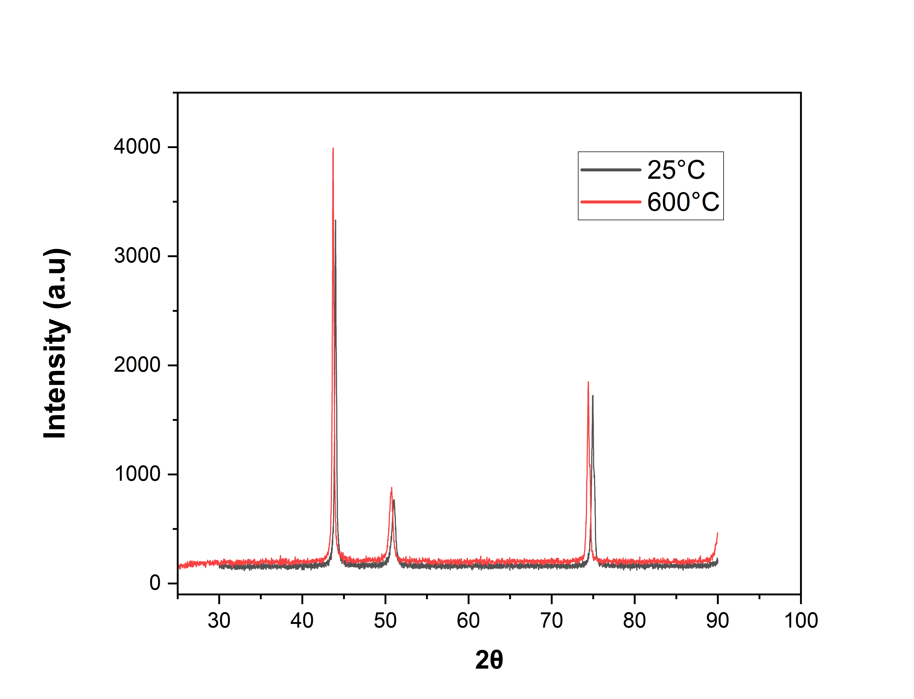
XRD
XRD at 600°C
At 25°C
Peak Position (2θ) | FWHM (β) | D(nm)
43.9978 | 0.27261 | 31.42997413
51.0008 | 0.57511 | 15.30443544
74.96447 | 0.42103 | 23.77782062
At 600°C
Peak Position (2θ) | FWHM (β) | D(nm)
43.71058 | 0.26577 | 32.2063612
50.68166 | 0.57905 | 15.18019362
74.42531 | 0.40939 | 24.3662412

Slide 21
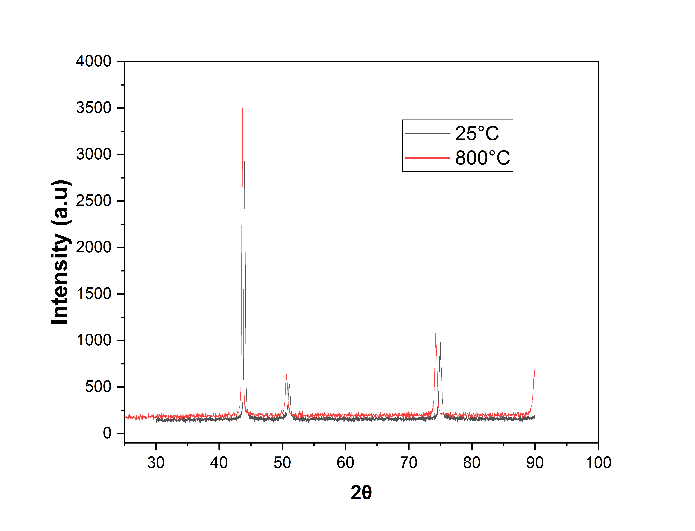
XRD
XRD at 800°C
At 25°C
Peak Position (2θ) | FWHM (β) | D(nm)
44.03049 | 0.26556 | 32.26808707
51.08381 | 0.45487 | 19.35669195
74.99698 | 0.48138 | 20.80135165
At 800°C
Peak Position (2θ) | FWHM (β) | D(nm)
43.66569 | 0.25101 | 34.09481929
50.65528 | 0.46623 | 18.85149638
74.29592 | 0.45538 | 21.88667875

Slide 22
XRD
Peak Shifting
[1 1 1] Peak
[2 0 0] Peak
[2 2 0] Peak
Temperature | Peak Shift
400°C | 0.1226
600°C | 0.28722
800°C | 0.3648
Temperature | Peak Shift
400°C | 0.13542
600°C | 0.31914
800°C | 0.42853
Temperature | Peak Shift
400°C | 0.23646
600°C | 0.53916
800°C | 0.70106
Observations:
Peak Shift increases with increasing temperature.
Peak Shift increases with increasing peak number.

Slide 23
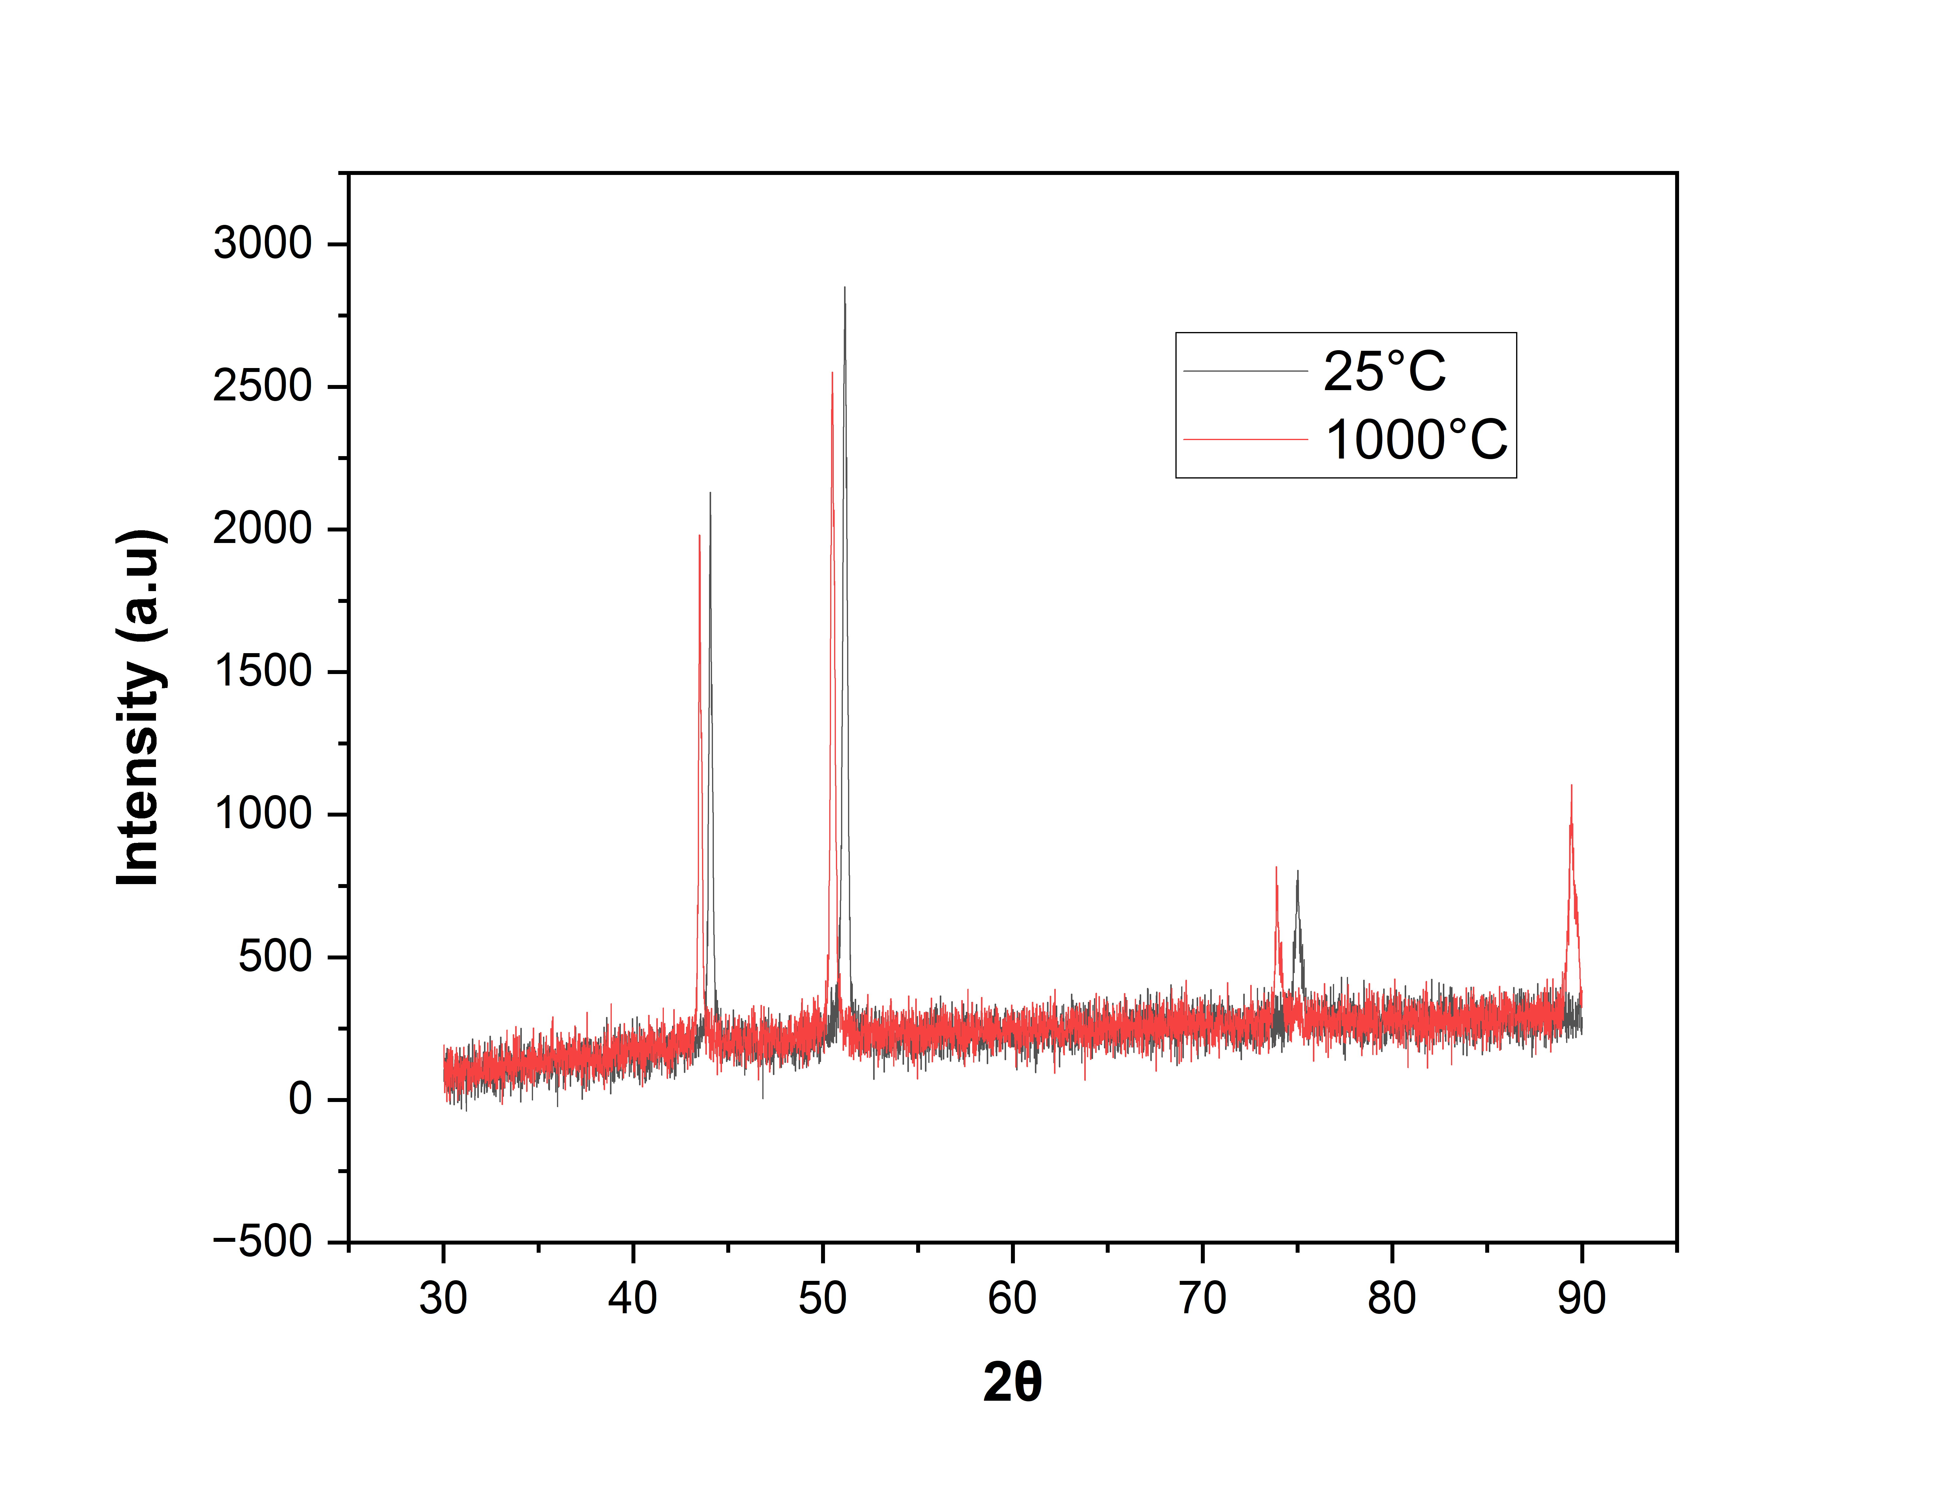
XRD
XRD at 1000°C

Slide 24
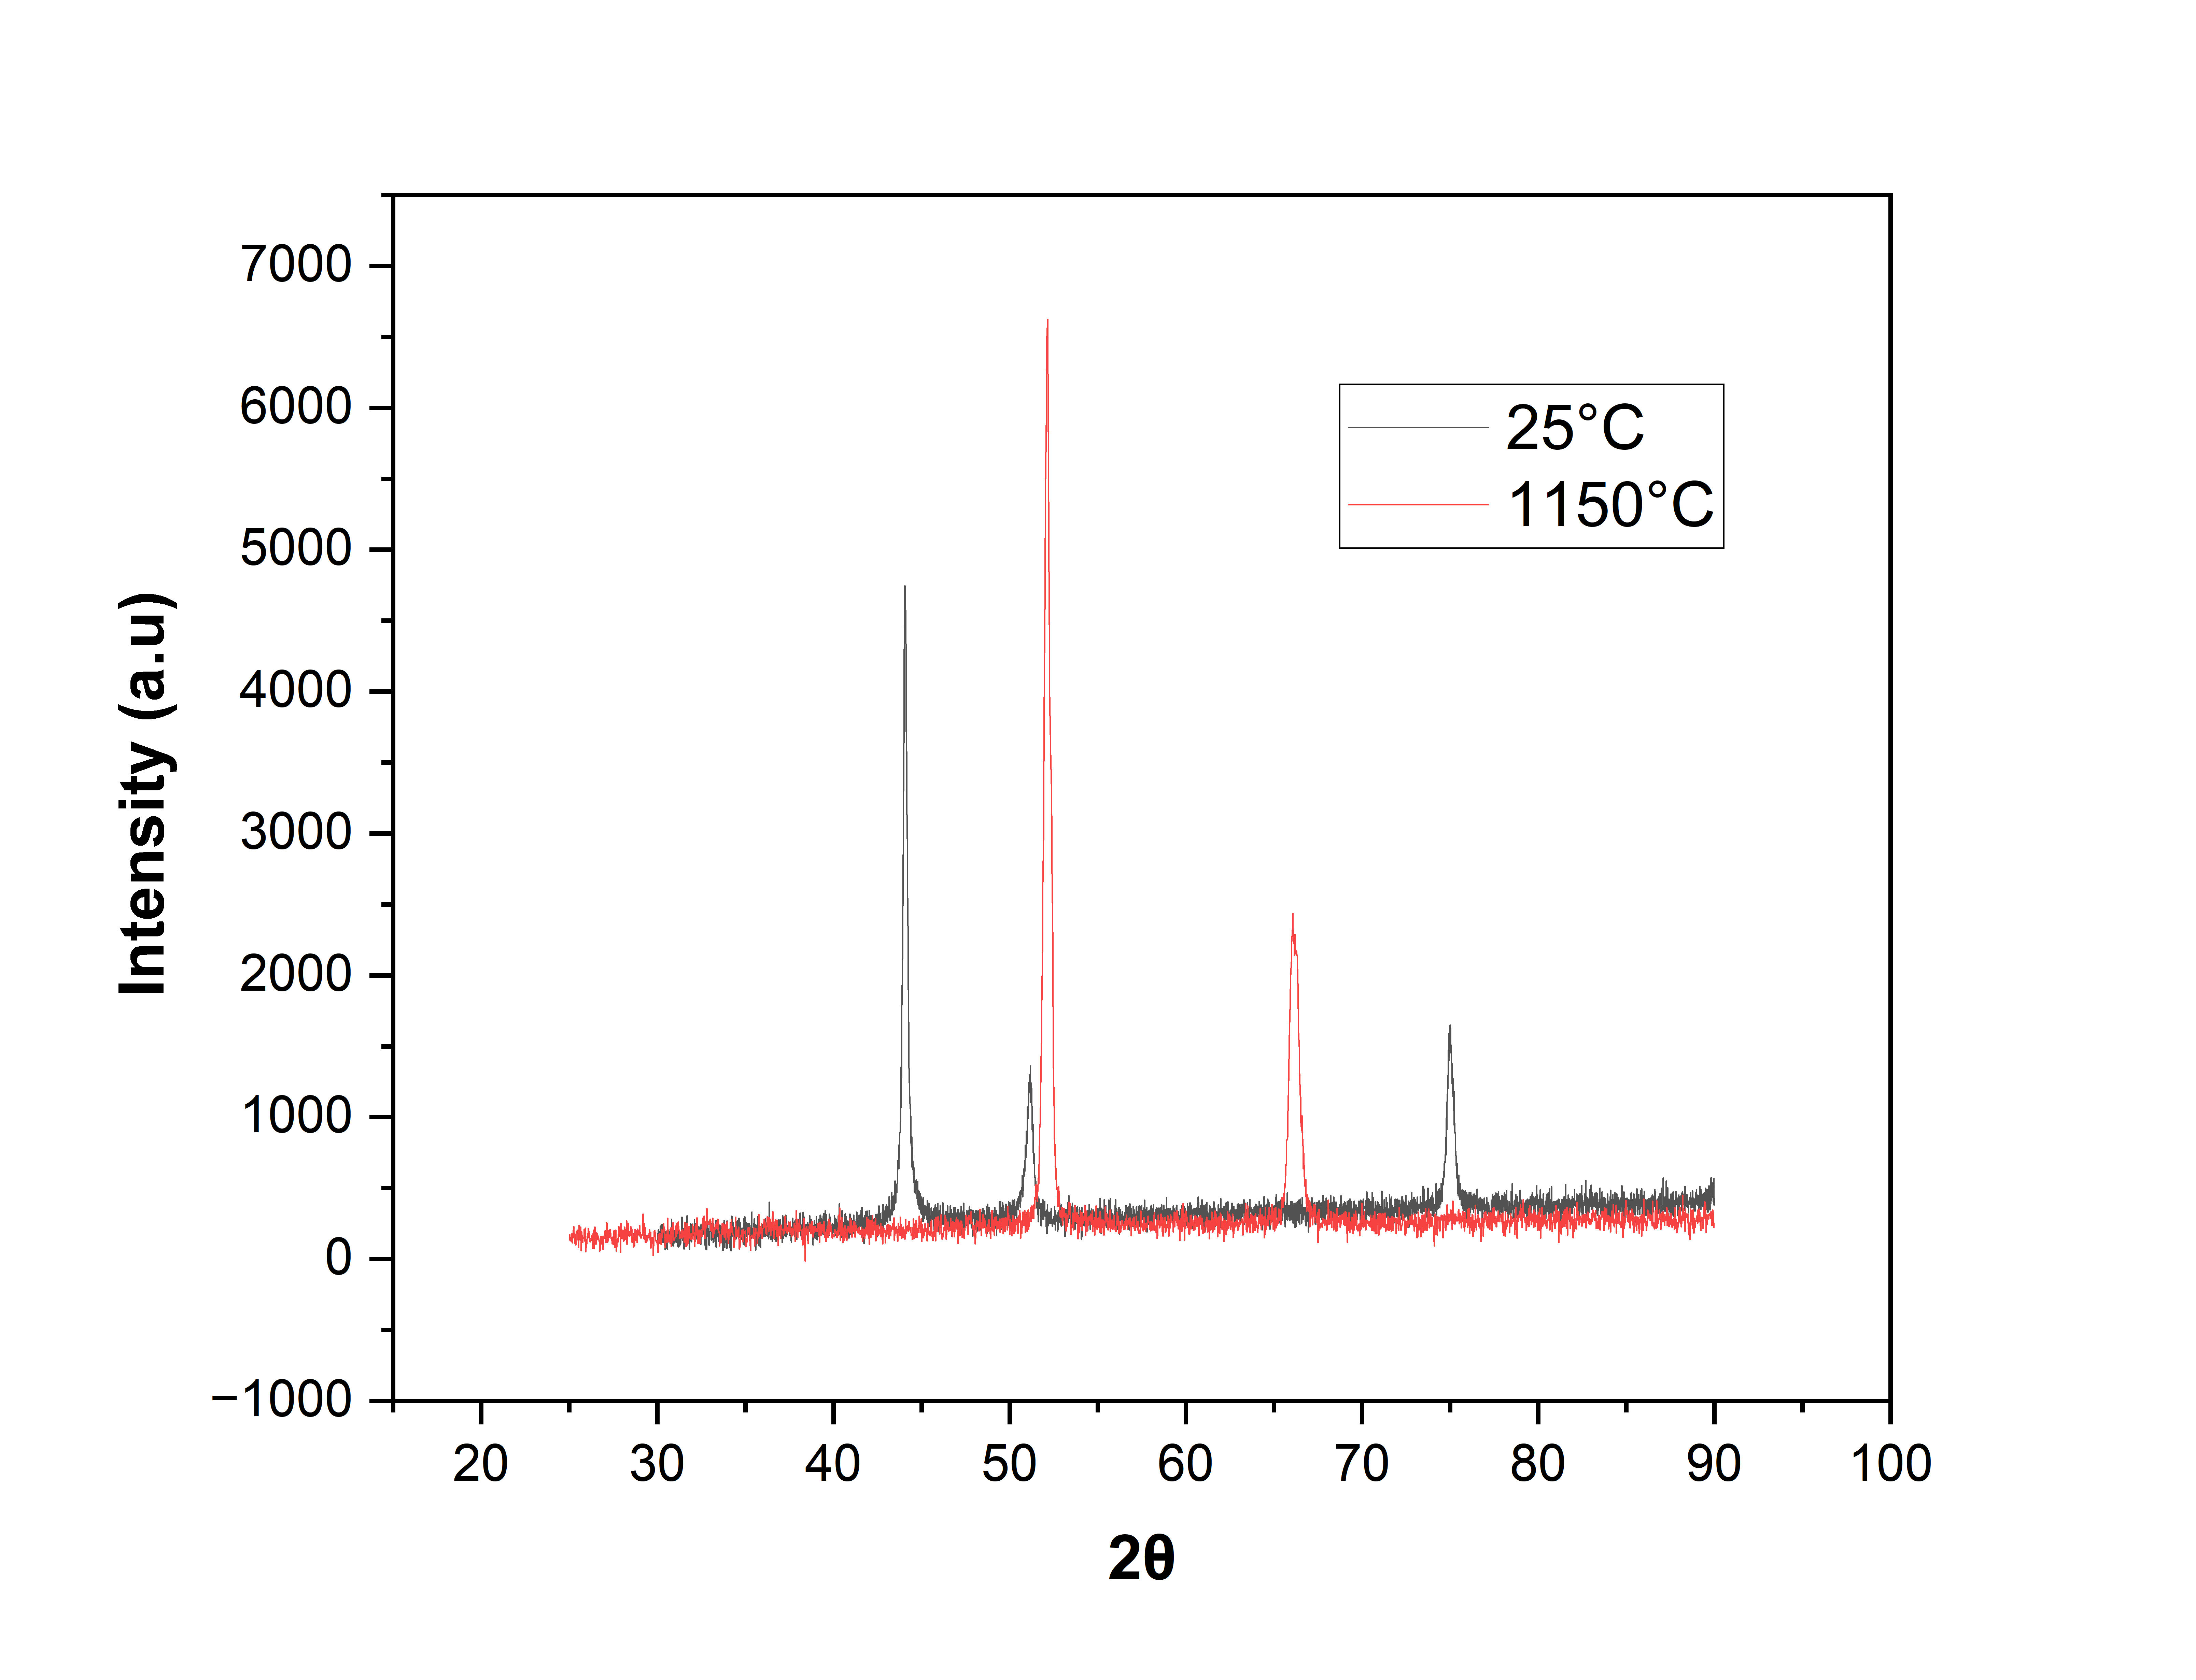
XRD
XRD at 1150°C

Slide 25
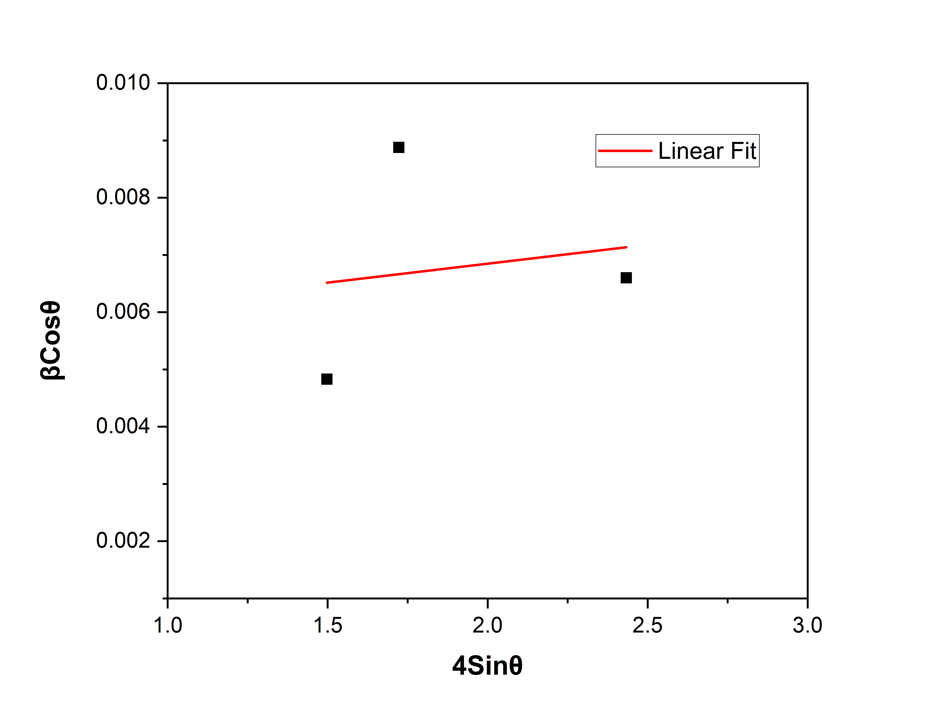
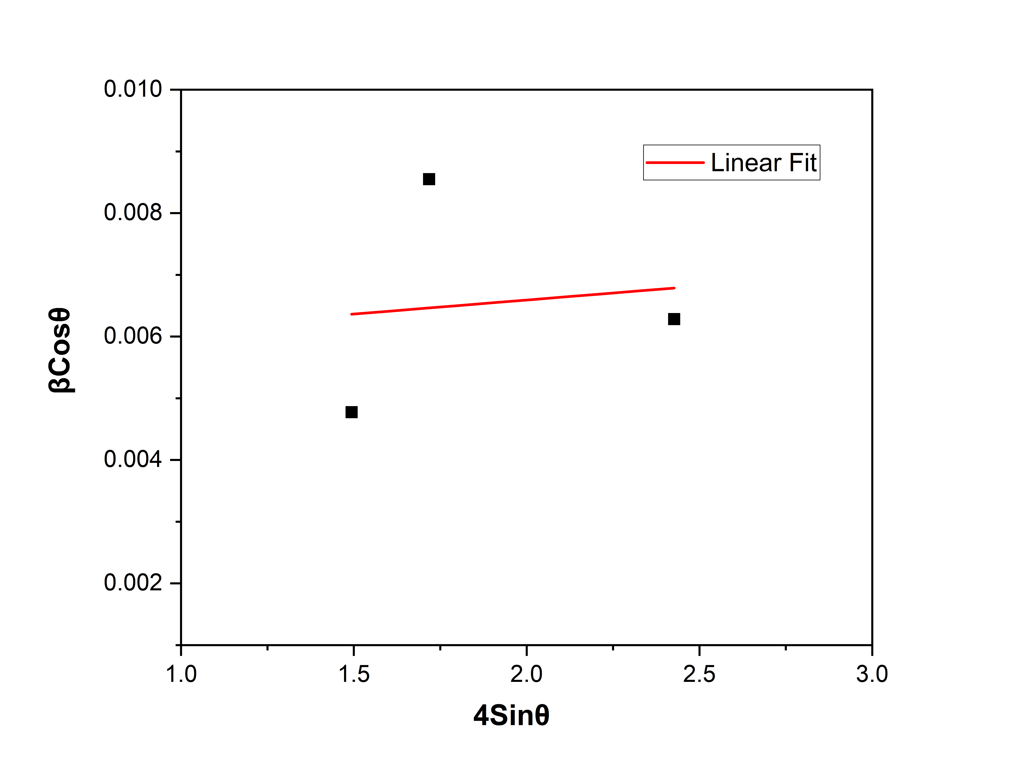
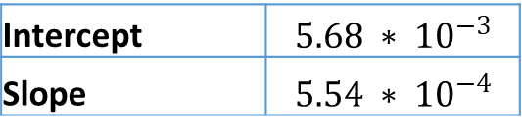
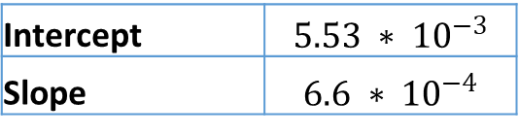
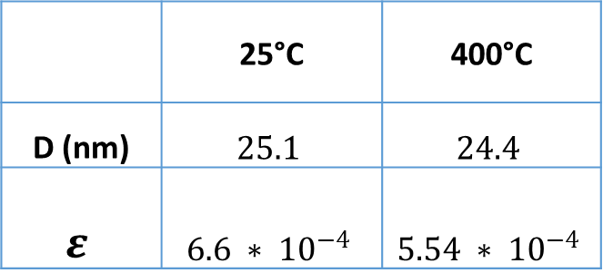
XRD
Williamson – Hall Analysis for 400°C
 | 25°C | 400°C
D (nm) | $$25.1$$ | $$24.4$$
$$ε$$ | $$6.6 ∗ {10}^{−4}$$ | $$5.54 ∗ {10}^{−4}$$
25°C
400°C
Intercept | $$5.53 ∗ {10}^{−3}$$
Slope | $$6.6 ∗ {10}^{−4}$$
Intercept | $$5.68 ∗ {10}^{−3}$$
Slope | $$5.54 ∗ {10}^{−4}$$

Slide 26
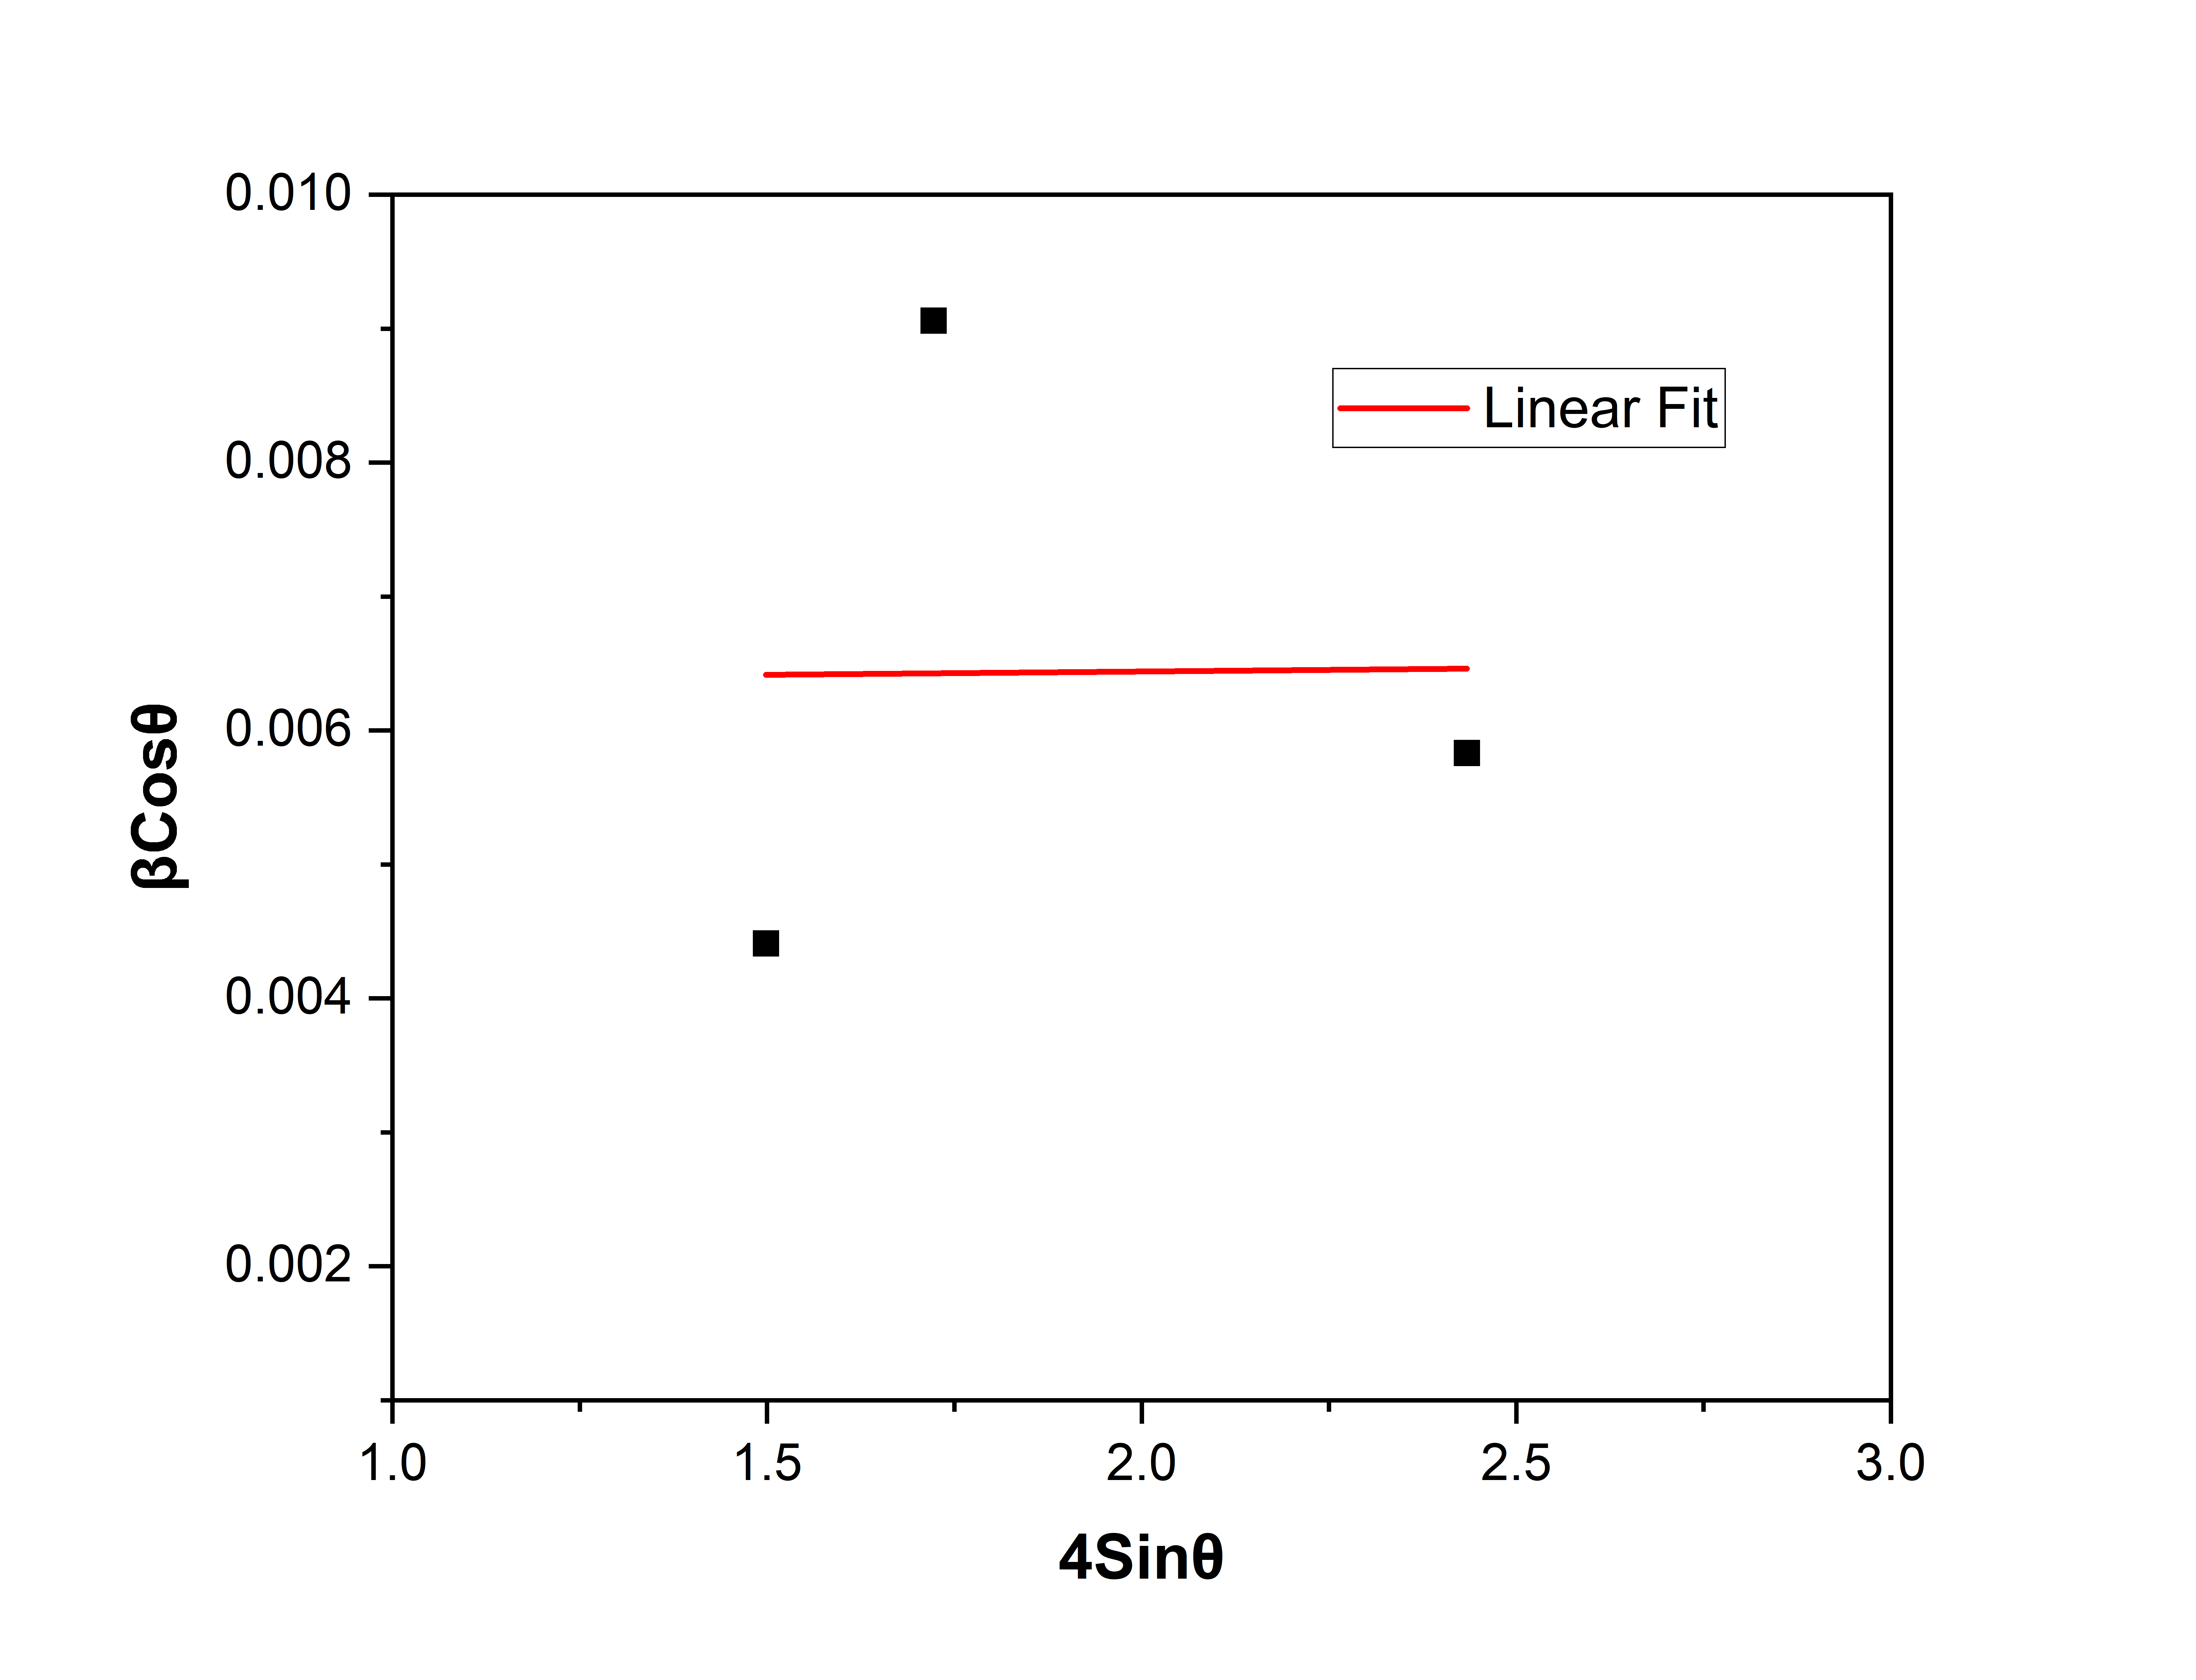
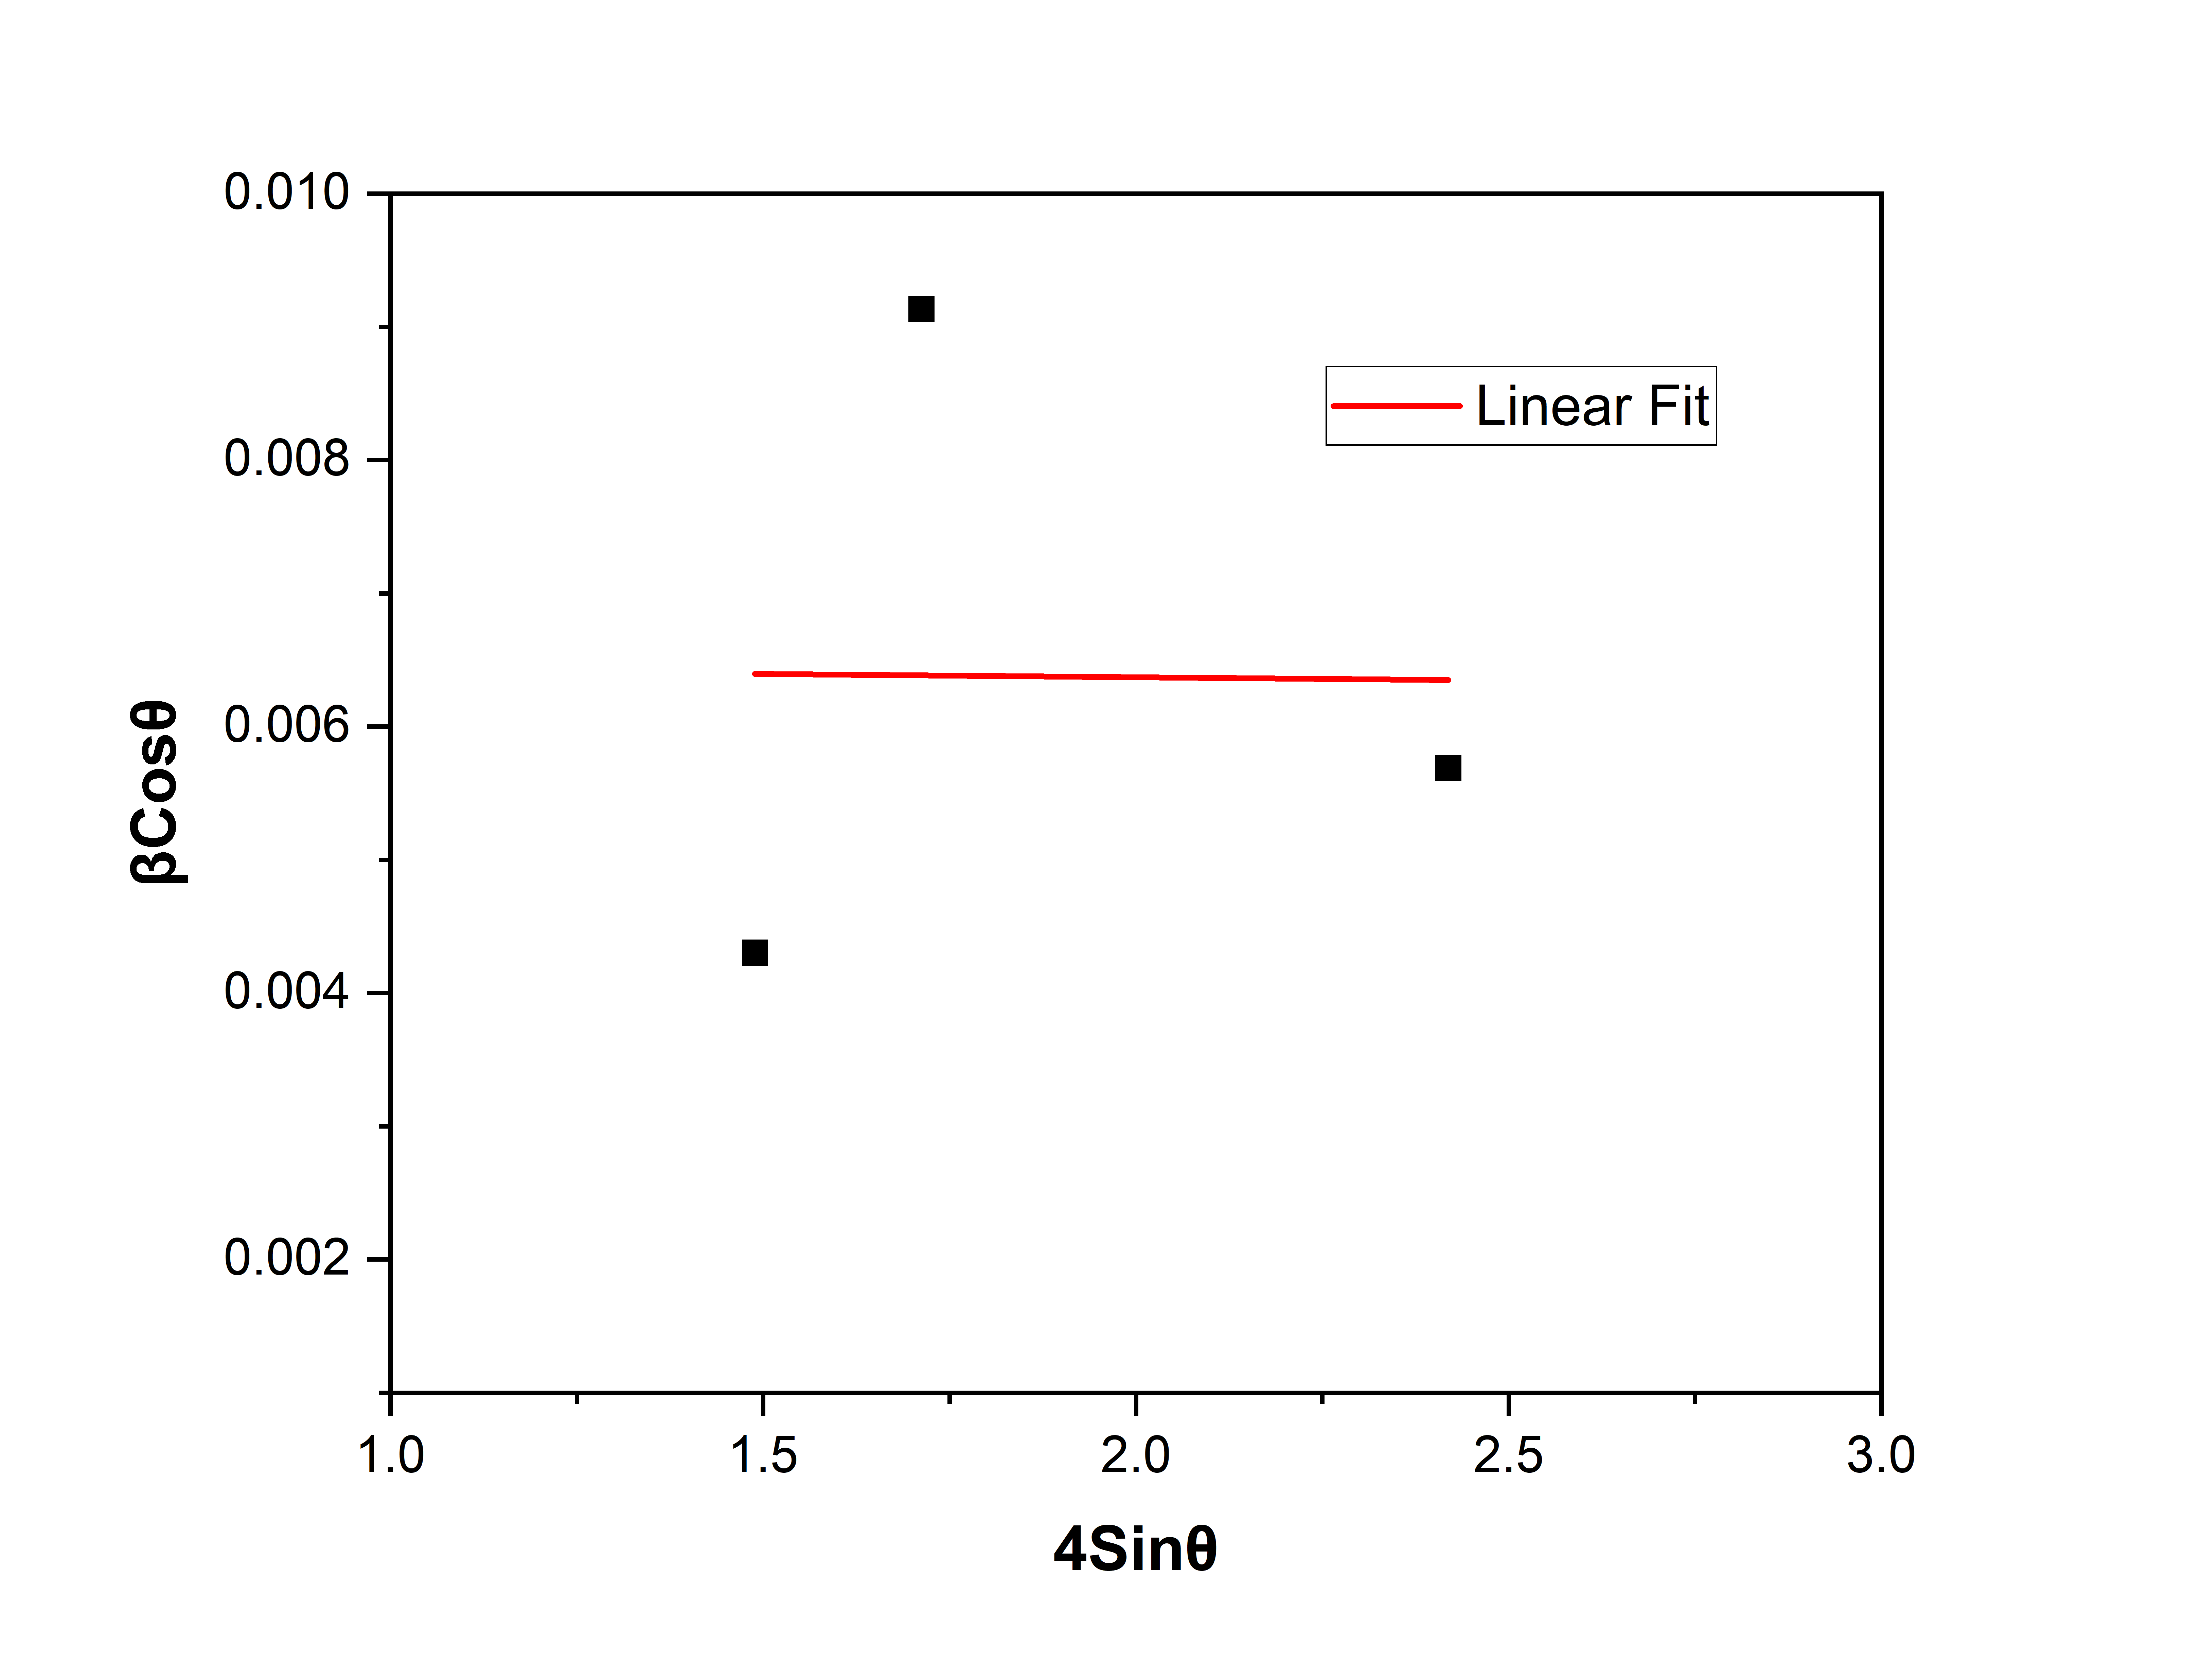
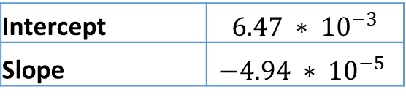

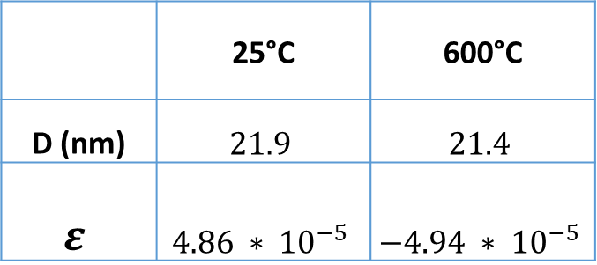
XRD
Williamson – Hall Analysis for 600°C
 | 25°C | 600°C
D (nm) | $$21.9$$ | $$21.4$$
$$ε$$ | $$4.86 ∗ {10}^{−5}$$ | $$−4.94 ∗ {10}^{−5}$$
25°C
600°C
Intercept | $$6.34 ∗ {10}^{−3}$$
Slope | $$4.86 ∗ {10}^{−5}$$
Intercept | $$6.47 ∗ {10}^{−3}$$
Slope | $$−4.94 ∗ {10}^{−5}$$

Slide 27
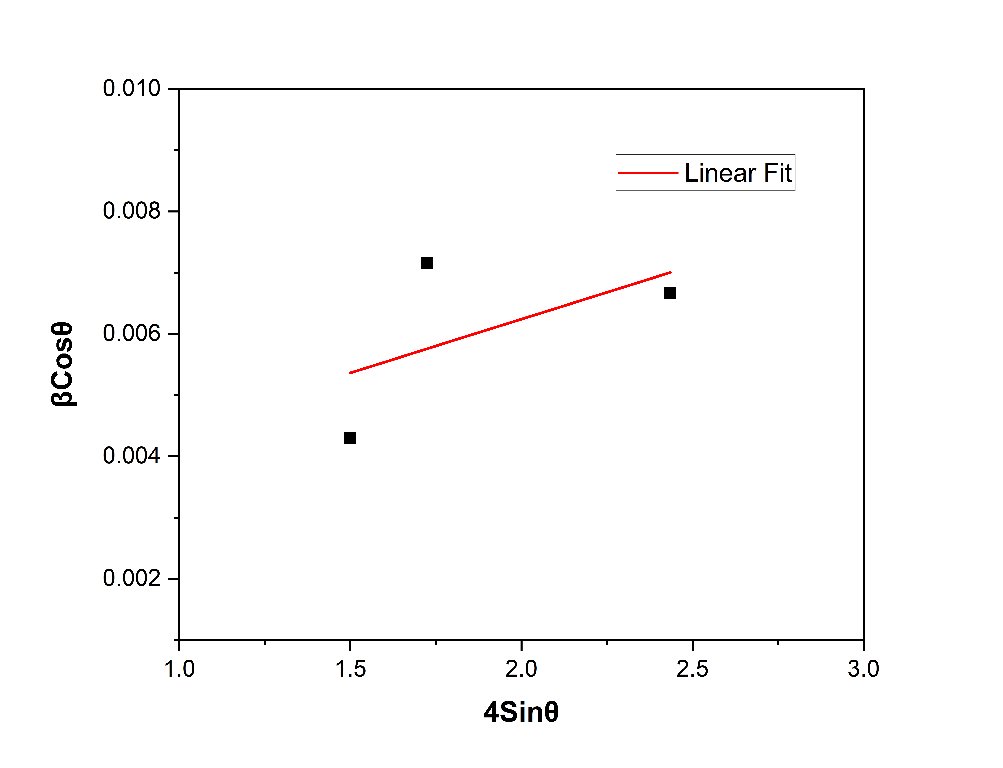




XRD
Williamson – Hall Analysis for 800°C
 | 25°C | 800°C
D (nm) | $$50.8$$ | $$44.72$$
$$ε$$ | $$1.75 ∗ {10}^{−3}$$ | $$1.51 ∗ {10}^{−3}$$
25°C
800°C
Intercept | $$2.73 ∗ {10}^{−3}$$
Slope | $$1.75 ∗ {10}^{−3}$$
Intercept | $$3.10 ∗ {10}^{−3}$$
Slope | $$1.51 ∗ {10}^{−3}$$

Slide 28
Further plan
Surface and Microstructure analysis.
Calculate Lattice Parameter, Interplanar distance, and Dislocation density.
Perform compression test and followed by sub-section analysis.

Slide 29
Thank You!

